Slide 1


Decision trees Random Forest
Theory + workshop

Slide 2
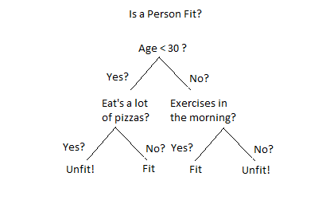
How does it works ?
Beginning
Numeric (value)
Categories
(yes / no)
End

Slide 3
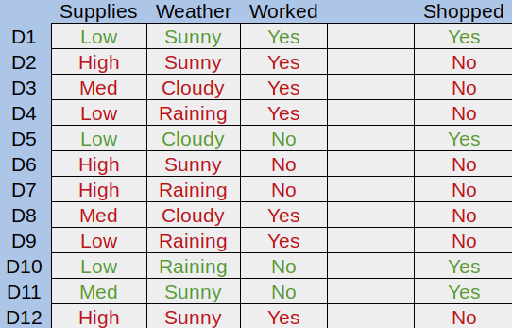
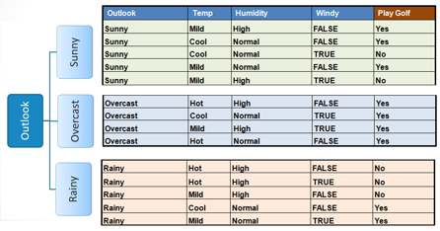
Decision trees, which data ?

Slide 4
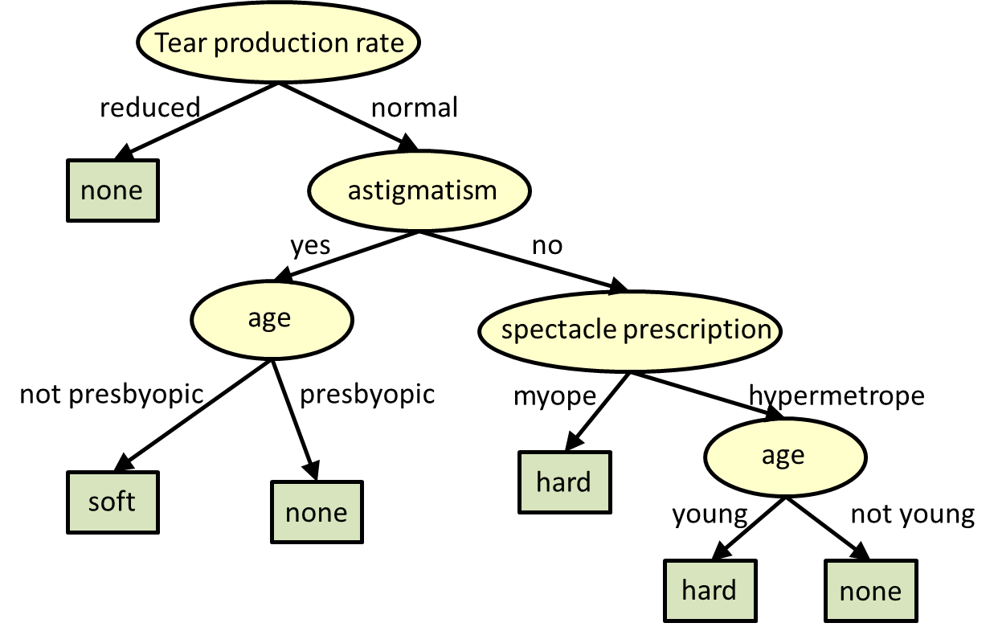
Jargon
Root node
Nodes
Leafs

Slide 5
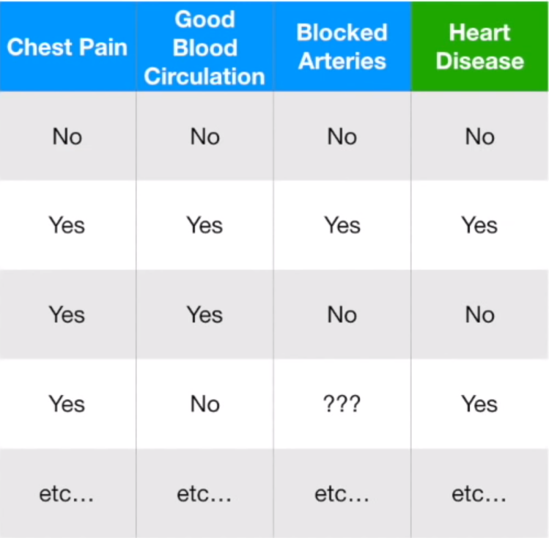
How do we create a decision tree ?
Variables
Question

Slide 6
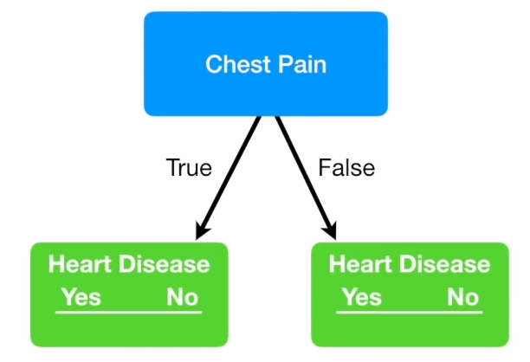
HOW DO WE CREATE A DECISION TREE ?

Slide 7
HOW DO WE CREATE A DECISION TREE ?
1

Slide 8
HOW DO WE CREATE A DECISION TREE ?
1
1

Slide 9
HOW DO WE CREATE A DECISION TREE ?
303 patients
105
39
34
125

Slide 10
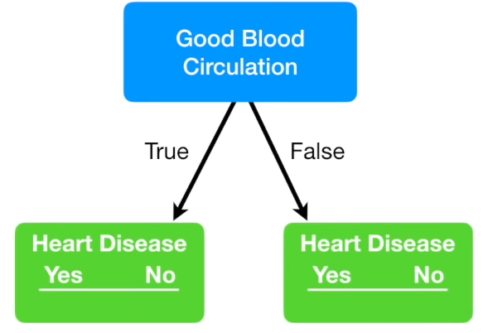
HOW DO WE CREATE A DECISION TREE ?
303 patients
37
127
100
33

Slide 11
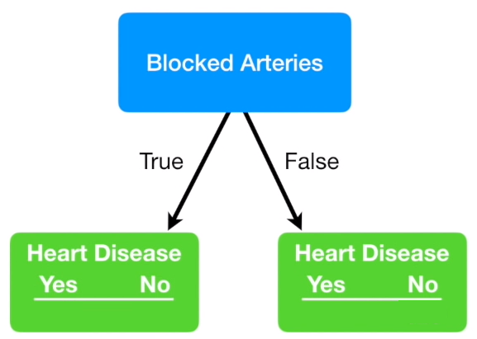
HOW DO WE CREATE A DECISION TREE ?
303 patients
92
31
45
129

Slide 12
Jargon
303 patients
303 patients
303 patients
105
39
34
125
37
127
100
33
92
31
45
129
No leaves are at 100%, they are considered as "impure"
45
129

Slide 13
Measure the impurity : GINI's algorithm
The Gini Impurity = 1 - P(Yes)² - P(No)²
GI : 1 – (34/159)² - (125/159)² = 0.336
GI : 1 – (105/144)² - (39/144)² = 0.395
Chest Pain Impurity :
GI: (144/303)*0.395 + (159/303)*0.336
GI = 0.364
144 patients
303 patients
159 patients
105
39
34
125

Slide 14
Measure the impurity : GINI's algorithm
The Gini impurity = 1 - P(Yes)² - P(No)²
GI : 1 – (100/133)² - (33/133)² = 0.349
GI : 1 – (37/164)² - (127/164)² = 0.373
Good Blood Circulation impurity :
GI: (164/297)*0.373 + (133/297)*0.349
GI = 0.360
164 patients
297 patients
133 patients
37
127
100
33

Slide 15
MEASURE THE IMPURITY : GINI'S ALGORITHM
303 patients
303 patients
303 patients
105
39
34
125
37
127
100
33
92
31
45
129
GI : 0.364
GI : 0.360
GI : 0.381
The "good blood circulation" parameter has the lower Gini impurity, we will use it at Root Node
45
129

Slide 16
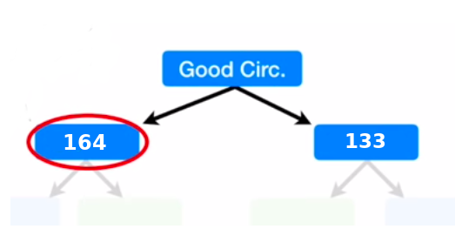
MEASURE THE IMPURITY : GINI'S ALGORITHM
Now, calculate the same way the impurity of each parameter for the 164 patients detected as having a good blood circulation.
We calculate, for each node, the impurity until there is no other parameter to use as a node.

Slide 17
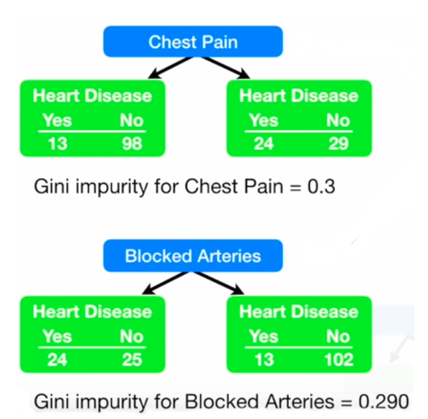
MEASURE THE IMPURITY : GINI'S ALGORITHM
Now, calculate the same way the impurity of each parameter for the 164 patients detected as having a good blood circulation.

Slide 18
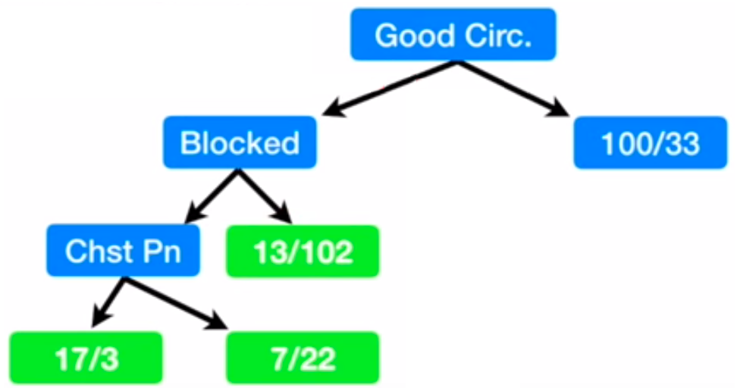
MEASURE THE IMPURITY : GINI'S ALGORITHM
By calculating the chest pain when the arteries aren't blocked, we see an impurity of 0.29. The impurity of the leaf surrounded in red is 0.2, so we keep it as a leaf and don't transform it has a node.﻿
If the impurity is higher at the next node, change the node by a leaf.

Slide 19
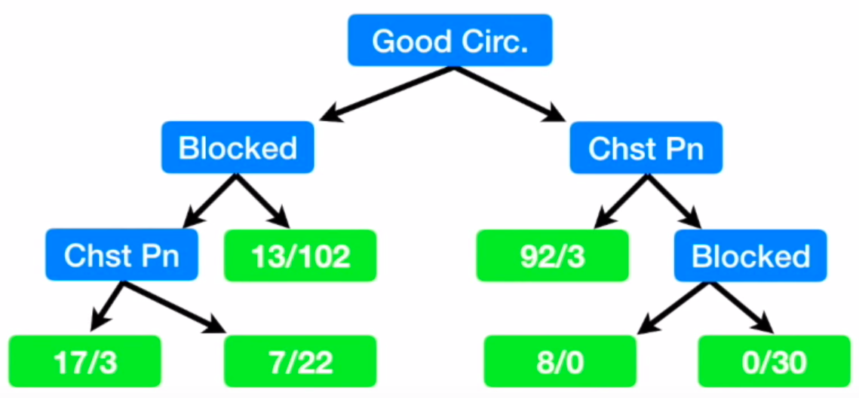
We made our tree !!!

Slide 20
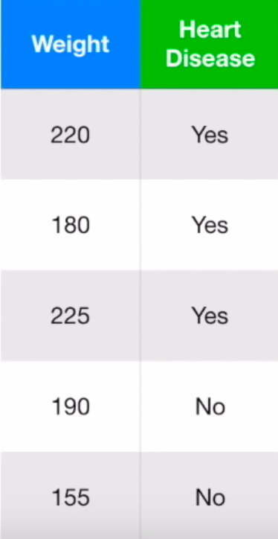
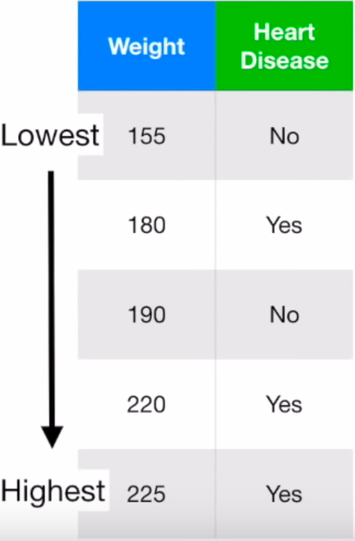
Use Numerical data : Preparing data
Calculating the average between
2 side values
167.5
Sorting by
ascending order
185
205
225.5

Slide 21
Use Numerical data : Compute impurity
GI = 1 – P(Yes)² - P(No)² for each patient under the chosen weight.
167.5
Giny impurty = 0,3
The lowest impurity
occurs when we separate using weight < 205.
185
Giny impurty = 0,47
205
Giny impurty = 0,27
225.5
Giny impurty = 0,4

Slide 22
LIMITS OF DECISION TREES
Advantages
Disadvantages
No overfitting
Good precision
Simplicity
Bad scalling to another dataset
Compute the tree again for each new batch of data
Can't handle new variables

Slide 23
Random Forest
Theory + workshop

Slide 24
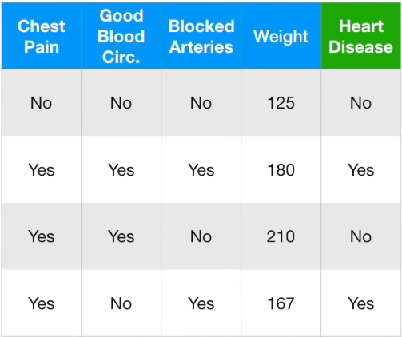
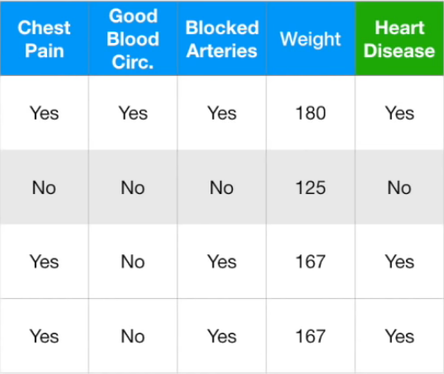
HOW TO Create a Bootstrapped dataset ?
Original Dataset
Bootstrapped Dataset

Slide 25
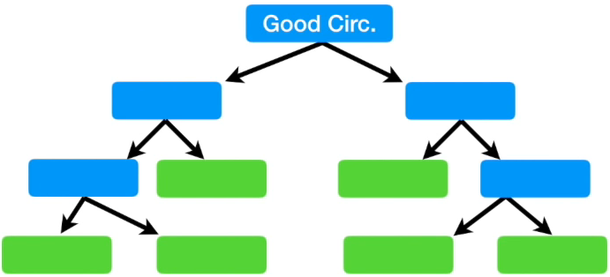
Create a decision tree using this dataset
Bootstrapped Dataset
For each node, take a random parameter (limited).
We will compute the impurity of each selected parameter and take the lowest.

Slide 26
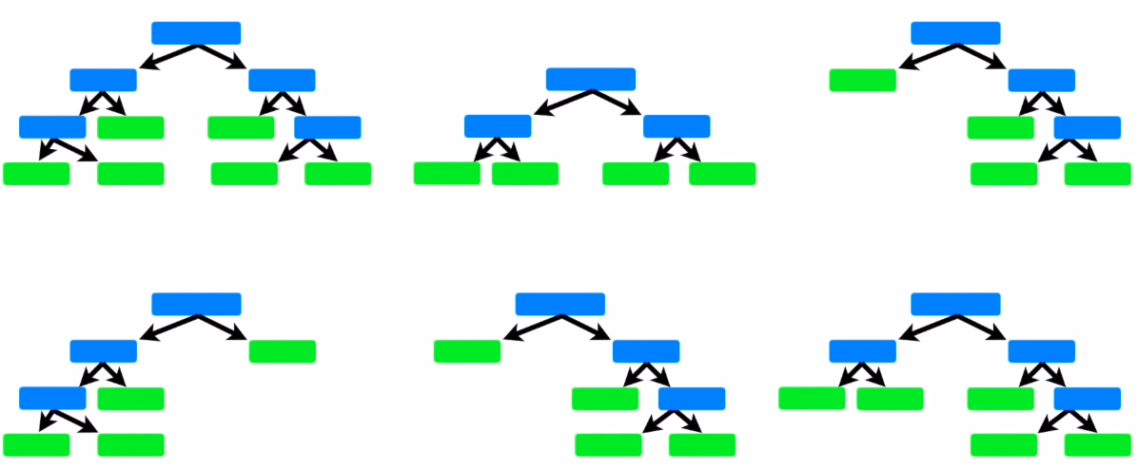
Create a decision tree using this dataset
We generate a big number of tree (ex: 10000) with random parameters and bootstrapped datasets:

Slide 27
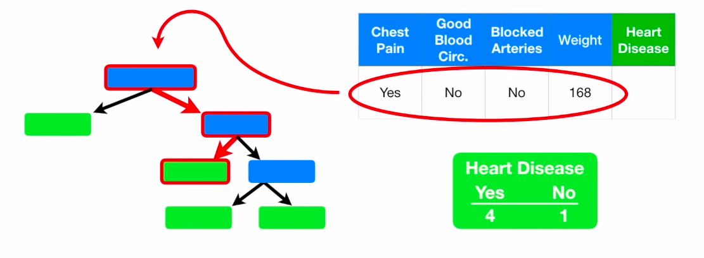
Use a random forest
Now we can give to all the trees a new patient, we look at what the majority says. It must be right...
YES

Slide 28
How to test our random forest ?
Out-Of-Bag Dataset
Compute sample with all trees to get an answer, majority still win...

Slide 29
The "out-of-bag error"
The "out-of-bag error" :
nb of incorrect answers / nb of samples
Results, a way to optimise...

